Slide 1
Welcomes You
Data Analysis and AI
Orientation

Slide 2
Introduction
Prasad Charate
Worked as a Jr. Data Scientist with 3+ years of experience in Data Science, Machine Learning, and Analytics.
Hands-on expertise in Deep Learning, NLP, Computer Vision, and Power BI dashboard development.
Proven ability in training and mentoring students and professionals in real-world Data Science applications for more then 3+ years +1 year in freelance mentoring .

Slide 3
Agenda
Our Journey So Far
Data and Its Importance
Data Analysis Project Life Cycle
Real-time Case Study Example
Data Science Application
Job Opportunities in Data Analysis / Data Scientist
Market Trends
Required Skills to be a Data Analyst / Data Scientist
Mapping to DA/DS Curriculum

Slide 4
GROUND RULES
Listen actively and attentively
Be on mute while the session is going on
Questions will be taken at the logical end of the topic
Raise your hand/drop a message in chat box before question is asked
Respect others time and do not monopolize the discussion
Notes:
keep your zoom client on mute while the session is going on
raise your hand or drop a message on the chat window to interact with the instructor or ask questions
respect other attendees time

Slide 5


Data and its Importance in Today's World

Slide 6
Data Analysis Project lifecycle
Data Collection
Data Cleaning
Exploratory Data Analysis
Data Transformation
Visualization & Reporting
Decision Making & Business Impact
Understanding the business problem and collecting the right data needed to solve it.
Remove duplicates, errors, missing values, and standardize data formats to ensure accuracy and consistency.
Understand the data, find patterns, and get key insights using charts and basic statistics.
Use MySQL or Python to filter, combine, and prepare the data for better analysis.
Create dashboards, charts, and reports to show the results clearly and make them easy to understand and use.
Using the findings to make data-driven business decisions

Slide 7
Data
User ID | Name | Preference | Restaurant | Order ID | Order Time | Item Ordered | Order amount | Delivery area | Delivery time | Rating
001 | Krishna | Veg | Chutneys | 211 | 12:03 PM | Paneer Biryani | 350 | Miyapur cross road | 35 | 4
002 | Suresh | Non-Veg | Pista House | 311 | 12:22 PM | Mutton Biryani | 350 | Kukatpally | 25 | 5
003 | Kaushik | Non-Veg | Mehfil | 411 | 12:28 PM | Chicken Biryani | 320 | Nizampet | 23 | 5
004 | Rahul | Non-Veg | Pista House | 312 | 12:28 PM | Roti with Chicken curry | 300 | IDPL Colony | 35 | 2
005 | Surya | Non-Veg | Mehfil | 412 | 12:30 PM | Chicken fry Biryani | 340 | Mathrushree nagar | 35 | 2
006 | Shankar | Veg | Pista House | 313 | 12:32 PM | Roti with dal fry | 200 | ASR Nagar | 35 | 5
007 | Prakash | Non-Veg | Mehfil | 413 | 12:37 PM | Prawn Biryani | 380 | Pragathi Nagar | 30 | 4
008 | Balaji | Non-Veg | Pista House | 314 | 12:45 PM | Chicken Biryani | 320 | KPHB phase 9 | 25 | 4
009 | Anjali | Non-Veg | Mehfil | 414 | 12:52 PM | Mutton Biryani | 340 | Vivekanandha nagar | 40 | 2
002 | Suresh | Non-Veg | Pista House | 315 | 3:36 PM | Chicken 65 | 280 | Kukatpally | 35 | 2
010 | Karthik | Veg | Chutneys | 212 | 4:00 PM | Roti with dal fry | 300 | NRSA Colony | 22 | 4
011 | Madhuri | Non-Veg | Pista House | 316 | 05:00 PM | Prawn fry | 310 | Addagutta society | 25 | 5

Slide 8
Analysis: Customer Behavior
User ID | Name | Preference | Restaurant | Order ID | Order Time | Item Ordered | Order amount | Delivery area | Delivery time | Rating
001 | Krishna | Veg | Chutneys | 211 | 12:03 PM | Paneer Biryani | 350 | Miyapur cross road | 35 | 4
002 | Suresh | Non-Veg | Pista House | 311 | 12:22 PM | Mutton Biryani | 350 | Kukatpally | 25 | 5
003 | Kaushik | Non-Veg | Mehfil | 411 | 12:28 PM | Chicken Biryani | 320 | Nizampet | 23 | 5
004 | Rahul | Non-Veg | Pista House | 312 | 12:28 PM | Roti with Chicken curry | 300 | IDPL Colony | 35 | 2
005 | Surya | Non-Veg | Mehfil | 412 | 12:30 PM | Chicken fry Biryani | 340 | Mathrushree nagar | 35 | 2
006 | Shankar | Veg | Pista House | 313 | 12:32 PM | Roti with dal fry | 200 | ASR Nagar | 35 | 5
007 | Prakash | Non-Veg | Mehfil | 413 | 12:37 PM | Prawn Biryani | 380 | Pragathi Nagar | 30 | 4
008 | Balaji | Non-Veg | Pista House | 314 | 12:45 PM | Chicken Biryani | 320 | KPHB phase 9 | 25 | 4
009 | Anjali | Non-Veg | Mehfil | 414 | 12:52 PM | Mutton Biryani | 340 | Vivekanandha nagar | 40 | 2
002 | Suresh | Non-Veg | Pista House | 315 | 3:36 PM | Chicken 65 | 280 | Kukatpally | 35 | 2
010 | Karthik | Veg | Chutneys | 212 | 4:00 PM | Roti with dal fry | 300 | NRSA Colony | 22 | 4
011 | Madhuri | Non-Veg | Pista House | 316 | 05:00 PM | Prawn fry | 310 | Addagutta society | 25 | 5

Slide 9
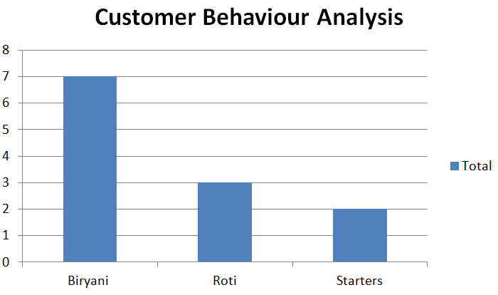
Analysis: Customer Behavior

Slide 10
Analysis: Customer Behavior
User ID | Name | Preference | Restaurant | Order ID | Order Time | Item Ordered | Order amount | Delivery area | Delivery time | Rating
001 | Krishna | Veg | Chutneys | 211 | 12:03 PM | Paneer Biryani | 350 | Miyapur cross road | 35 | 4
002 | Suresh | Non-Veg | Pista House | 311 | 12:22 PM | Mutton Biryani | 350 | Kukatpally | 25 | 5
003 | Kaushik | Non-Veg | Mehfil | 411 | 12:28 PM | Chicken Biryani | 320 | Nizampet | 23 | 5
004 | Rahul | Non-Veg | Pista House | 312 | 12:28 PM | Roti with Chicken curry | 300 | IDPL Colony | 35 | 2
005 | Surya | Non-Veg | Mehfil | 412 | 12:30 PM | Chicken fry Biryani | 340 | Mathrushree nagar | 35 | 2
006 | Shankar | Veg | Pista House | 313 | 12:32 PM | Roti with dal fry | 200 | ASR Nagar | 35 | 5
007 | Prakash | Non-Veg | Mehfil | 413 | 12:37 PM | Prawn Biryani | 380 | Pragathi Nagar | 30 | 4
008 | Balaji | Non-Veg | Pista House | 314 | 12:45 PM | Chicken Biryani | 320 | KPHB phase 9 | 25 | 4
009 | Anjali | Non-Veg | Mehfil | 414 | 12:52 PM | Mutton Biryani | 340 | Vivekanandha nagar | 40 | 2
002 | Suresh | Non-Veg | Pista House | 315 | 3:36 PM | Chicken 65 | 280 | Kukatpally | 35 | 2
010 | Karthik | Veg | Chutneys | 212 | 4:00 PM | Roti with dal fry | 300 | NRSA Colony | 22 | 4
011 | Madhuri | Non-Veg | Pista House | 316 | 05:00 PM | Prawn fry | 310 | Addagutta society | 25 | 5

Slide 11
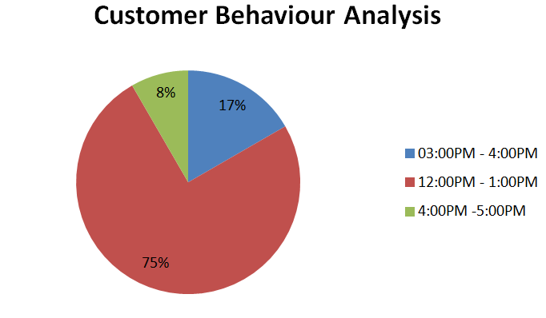
Analysis: Customer Behavior

Slide 12
Analysis: Delivery Performance
User ID | Name | Preference | Restaurant | Order ID | Order Time | Item Ordered | Order amount | Delivery area | Delivery time | Rating
001 | Krishna | Veg | Chutneys | 211 | 12:03 PM | Paneer Biryani | 350 | Miyapur cross road | 35 | 4
002 | Suresh | Non-Veg | Pista House | 311 | 12:22 PM | Mutton Biryani | 350 | Kukatpally | 25 | 5
003 | Kaushik | Non-Veg | Mehfil | 411 | 12:28 PM | Chicken Biryani | 320 | Nizampet | 23 | 5
004 | Rahul | Non-Veg | Pista House | 312 | 12:28 PM | Roti with Chicken curry | 300 | IDPL Colony | 35 | 2
005 | Surya | Non-Veg | Mehfil | 412 | 12:30 PM | Chicken fry Biryani | 340 | Mathrushree nagar | 40 | 1
006 | Shankar | Veg | Pista House | 313 | 12:32 PM | Roti with dal fry | 200 | ASR Nagar | 35 | 5
007 | Prakash | Non-Veg | Mehfil | 413 | 12:37 PM | Prawn Biryani | 380 | Pragathi Nagar | 30 | 4
008 | Balaji | Non-Veg | Pista House | 314 | 12:45 PM | Chicken Biryani | 320 | KPHB phase 9 | 25 | 4
009 | Anjali | Non-Veg | Mehfil | 414 | 12:52 PM | Mutton Biryani | 340 | Vivekanandha nagar | 40 | 2
002 | Suresh | Non-Veg | Pista House | 315 | 3:36 PM | Chicken 65 | 280 | Kukatpally | 35 | 2
010 | Karthik | Veg | Chutneys | 212 | 4:00 PM | Roti with dal fry | 300 | NRSA Colony | 22 | 4
011 | Madhuri | Non-Veg | Pista House | 316 | 05:00 PM | Prawn fry | 310 | Addagutta society | 25 | 5

Slide 13
Analysis: Delivery Performance

Slide 14
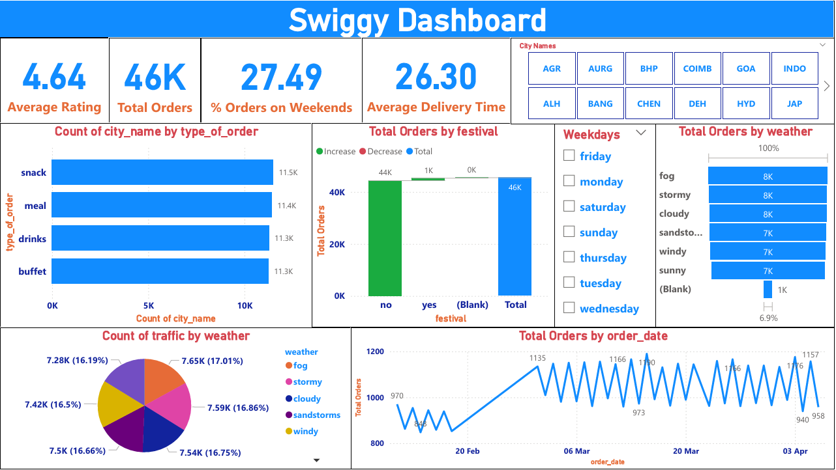
Power BI

Slide 15
The Complete Data Analysis Journey
Step | Tool | Purpose
1 | Python | Clean & Explore (EDA)
2 | Excel | Quick analysis & basic visualizations for small datasets
3 | SQL | Store & Query Large Datasets
4 | Power BI | Visualize, Share, Make Decisions

Slide 16
Data Analyst
Art of Understanding the Data + Finding the Pattern

Slide 17
Data Science
Art of Understanding the Data + Finding the Pattern + Building Predictive Models

Slide 18
Data science Project lifecycle
Exploratory Data Analysis
Data Preprocessing
Model Selection and Evaluation.
Data Collection
Model Building
Model Deployment
Business underdoing and Collecting the data required to solve the business problem
Understanding the data
Cleaning the data
Training the Machine learning model to address the business problem
Evaluating the model built
Deploying the model in clients environment

Slide 19
Let us play with a few AI tools that are free to use and can help in our day-to-day life.
ChatGpt
Gamma.app
Merlin
Playground
Yoodli

Slide 20
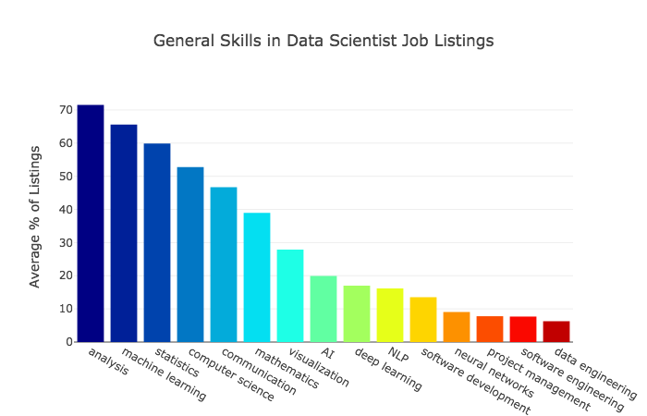
Job Opportunities in Data Analytics and Data Science
If you learn data science, then you get the opportunity to find the various exciting job roles in this domain.
Data Analyst
Business Analyst
Data Scientist
Data Engineer
Machine learning engineer
AI Engineer

Slide 21
Role of Data Scientist
There is extensive use of mathematics and statistics, the use of descriptive techniques and predictive models to gain valuable knowledge from data.
The insights from data are used to recommend action or to guide decision making rooted in business context
Data Scientist
Descriptive
Analytics
Predictive
Analytics
Prescriptive
Analytics
Descriptive Analytics – Analyzing historical data using aggregation, visualization, and data mining to understand patterns and trends. This helps answer the question: “What has happened?”
Predictive Analytics – Building statistical models and using forecasting techniques to anticipate future outcomes. This helps answer: “What could happen?”
Prescriptive Analytics – Applying optimization, machine learning, and simulation algorithms to suggest the best course of action. This addresses the question: “What should we do?”

Slide 22
Who can Learn - Prerequisite for data science
Who can Learn Data Science?
Any Graduate
Non-IT
No prior coding skills
Exceptional curiosity

Slide 23
What are the Required Skills to be a Data Scientist?
Becoming a successful data scientist requires a blend of both technical proficiency and soft skills.
Formal Education
A graduation is usually the basic requirement to start a career in data scientist.
Alternatively, individuals with the right skills and practical experience can also get entry-level roles in data science.
Technical Skills
Programming Languages.
Databases and SQL.
Data Visualization Tools.
Statistics
AI / Machine Learning
Deep Learning
Soft Skills
Critical Thinking
Problem-Solving.
Communication and Storytelling.
Curiosity and Continuous Learning.
Collaboration and Teamwork.
By cultivating this unique combination of technical expertise and soft skills, individuals can position
themselves for success in the growing field of data analysis.

Slide 24
Roadmap to become a Data Scientist
1
Python – Core, Advanced and Data Analysis
Data Science
2
Statistics and Probability
3
SQL and Visualization Tool (Tableau)
4
Mathematics(Linear Algebra. Matrices, etc.,)
5
Machine Learning
6
Deep Learning, Computer Vision and NLP (AI)

Slide 25
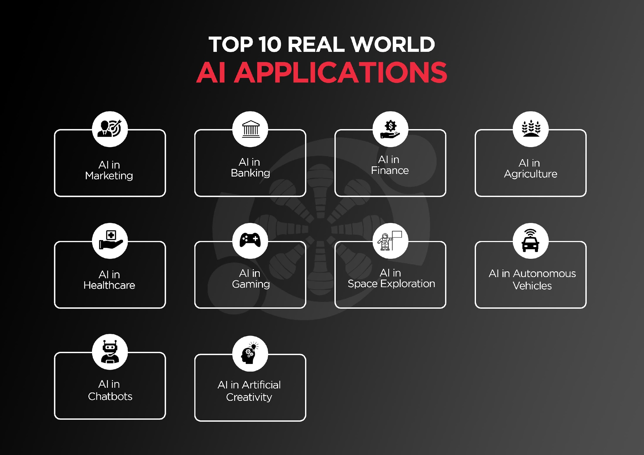

Slide 26
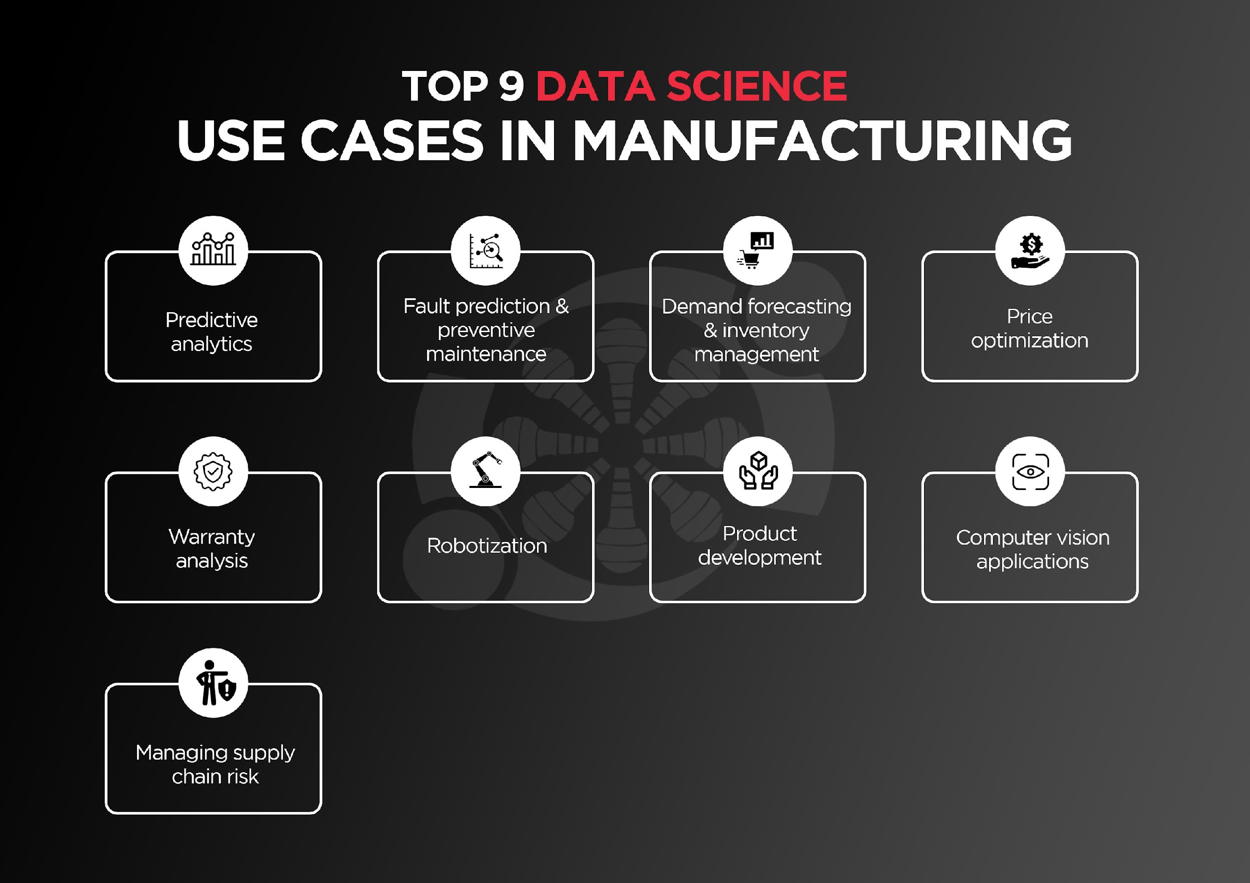

Slide 27
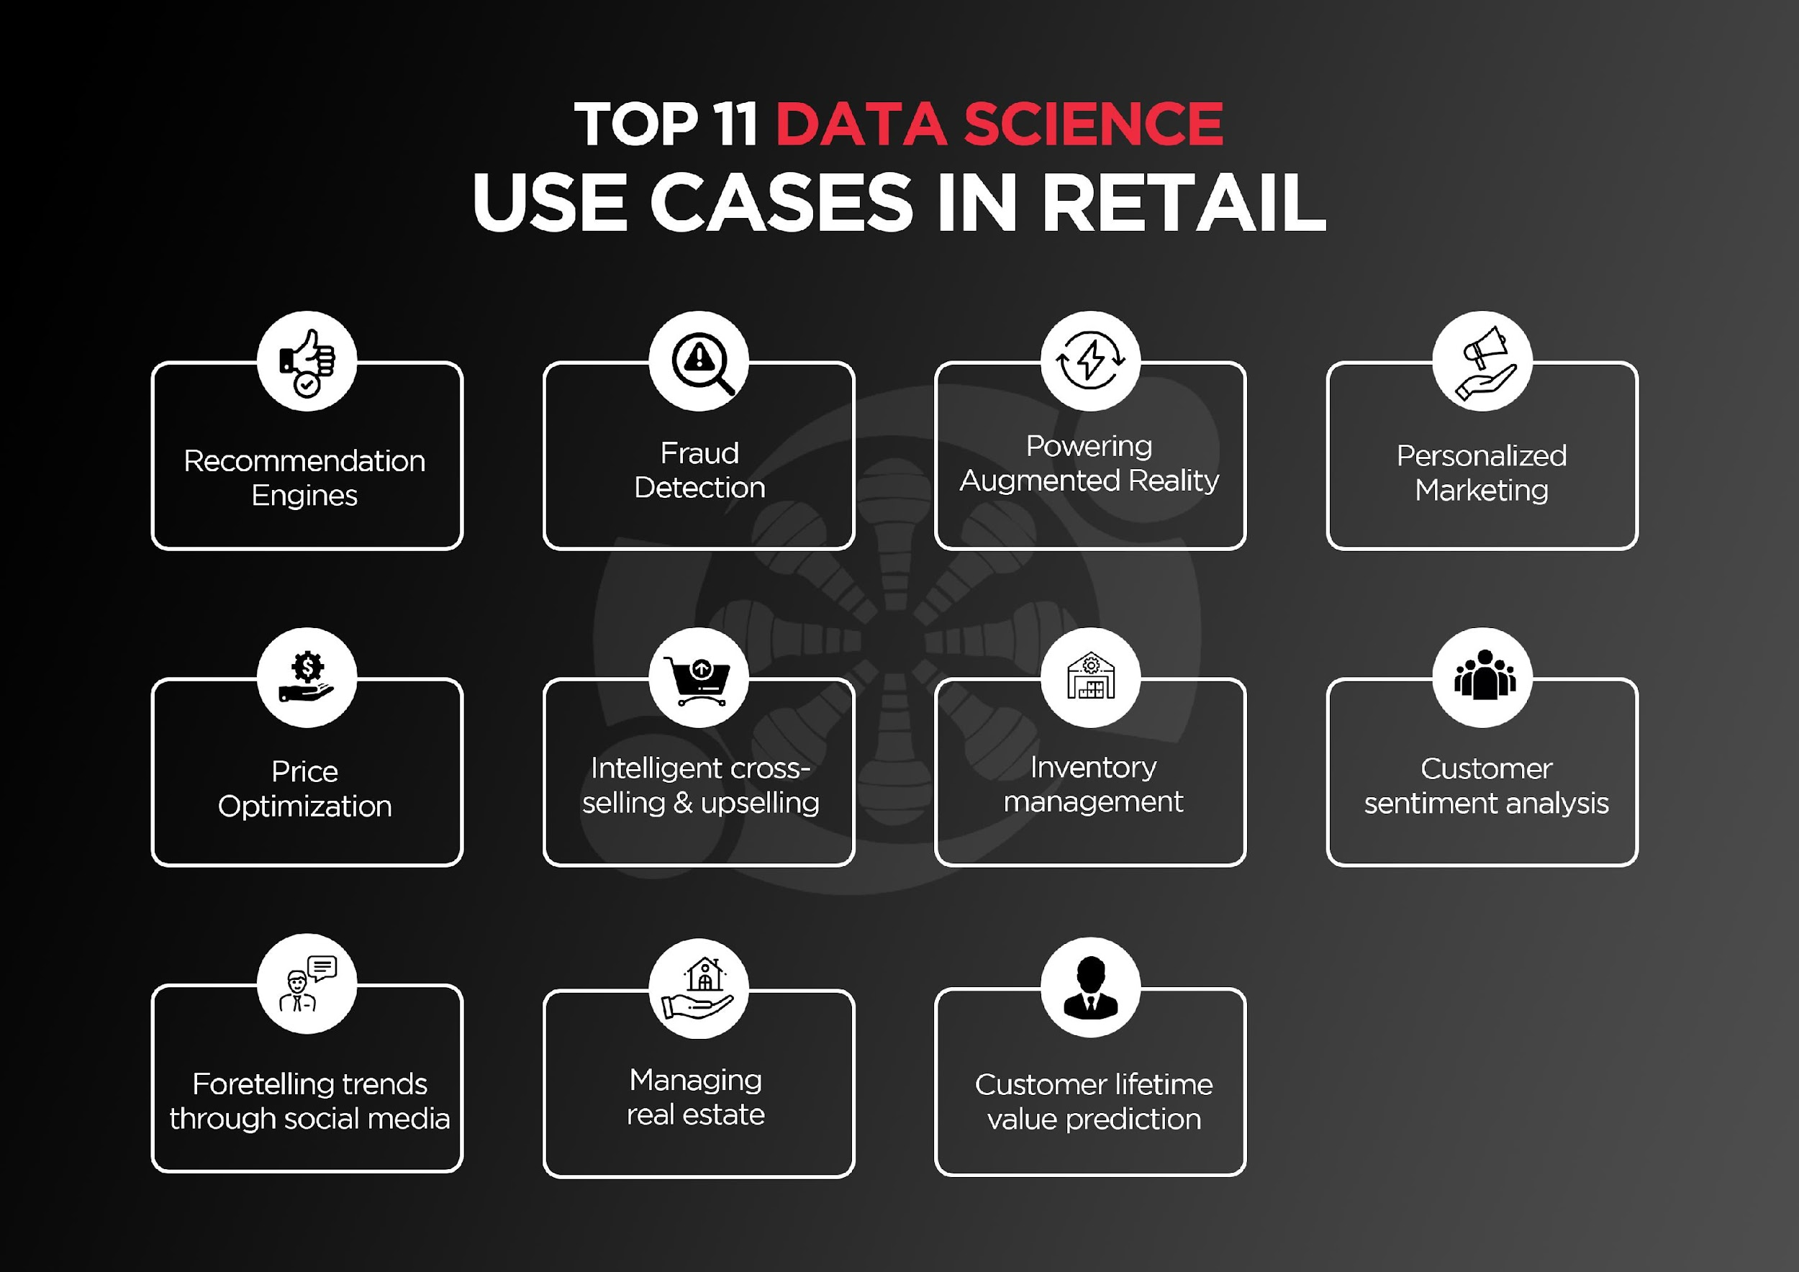

Slide 28
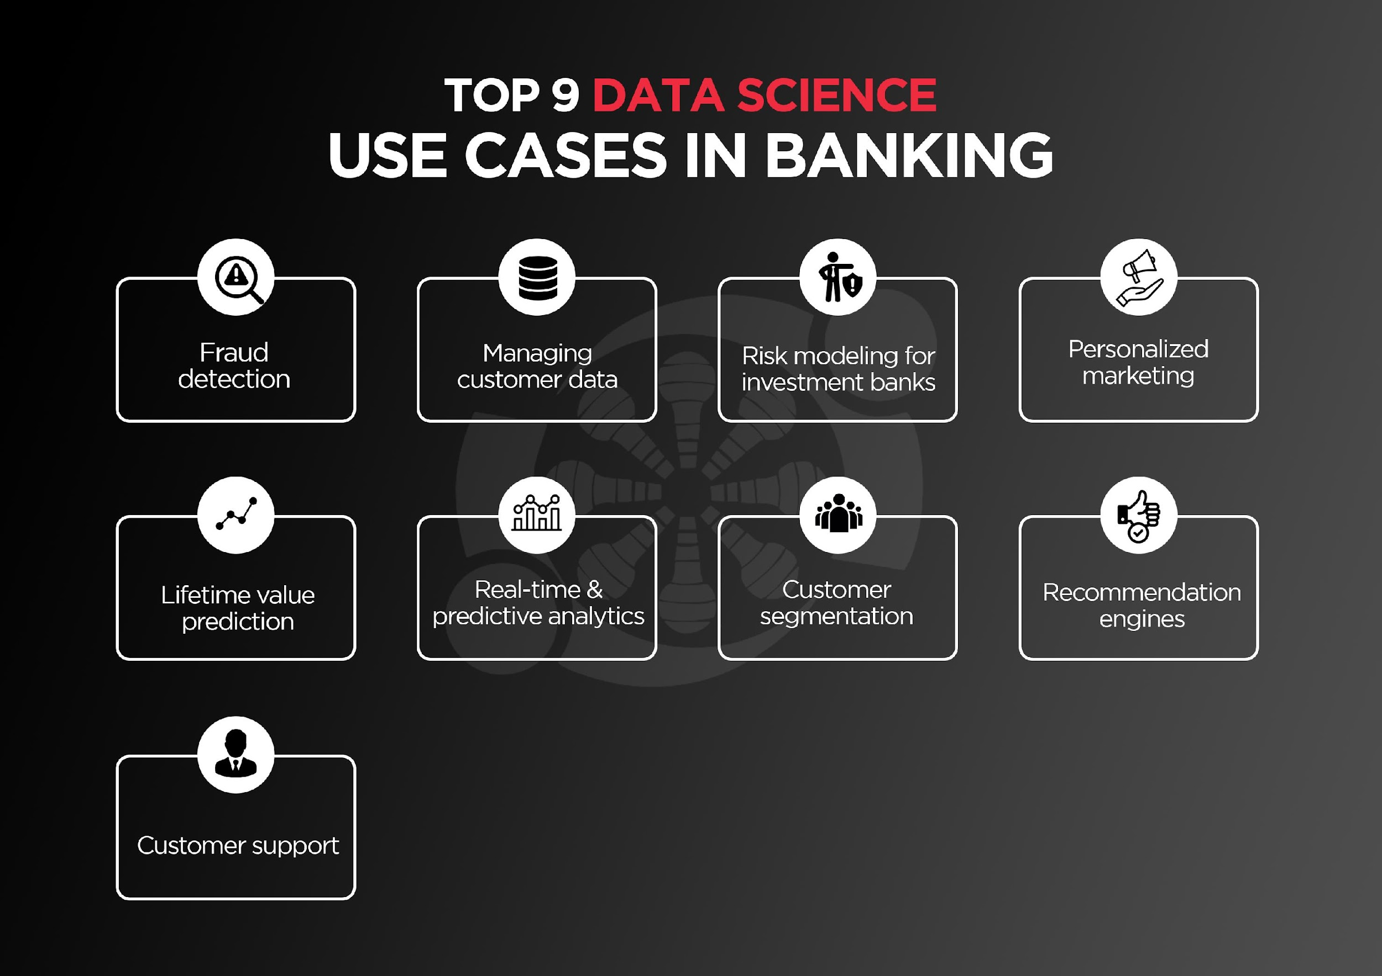

Slide 29
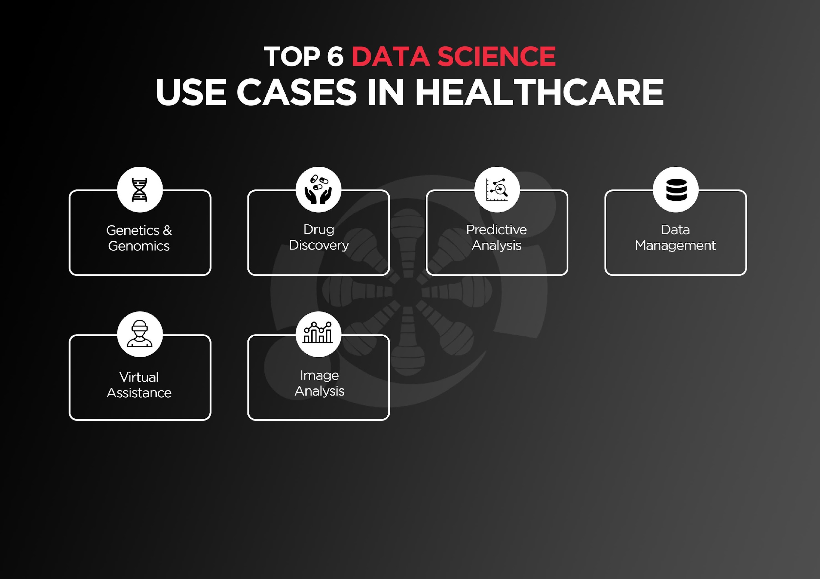

Slide 30


